Slide 1
SUDAKSHA EDUCATION PVT LTD
Java Course Content

Slide 2
Table of Content
Java Basics
Java GUI
Java Collections
Java Swing
Event handling in Desktop applications
Java Stream
Functional Interfaces
Java Lambda
Java Regex
Java Concurrency

Slide 3
JDBC
Spring Cloud
Netflix Eureka Server
Load Balancing
Circuit Breaking
Resillience4J

Slide 4
Introduction to Java
Java programming language was originally developed by Sun Microsystems which was initiated by James Gosling and released in 1995 as core component of Sun Microsystems' Java platform (Java 1.0 [J2SE]). Features of Java:-
Object Oriented − In Java, everything is an Object. Java can be easily extended since it is based on the Object model.
Platform Independent − Unlike many other programming languages including C and C++, when Java is compiled, it is not compiled into platform specific machine, rather into platform independent byte code. This byte code is distributed over the web and interpreted by the Virtual Machine (JVM) on whichever platform it is being run on.
Simple − Java is designed to be easy to learn. If you understand the basic concept of OOP Java, it would be easy to master.
Secure − With Java's secure feature it enables to develop virus-free, tamper-free systems. Authentication techniques are based on public-key encryption.

Slide 5
Portable − Being architecture-neutral and having no implementation dependent aspects of the specification makes Java portable. Compiler in Java is written in ANSI C with a clean portability boundary, which is a POSIX subset.
Robust − Java makes an effort to eliminate error prone situations by emphasizing mainly on compile time error checking and runtime checking.
Multithreaded − With Java's multithreaded feature it is possible to write programs that can perform many tasks simultaneously. This design feature allows the developers to construct interactive applications that can run smoothly.
Interpreted − Java byte code is translated on the fly to native machine instructions and is not stored anywhere. The development process is more rapid and analytical since the linking is an incremental and light-weight process.

Slide 6
Hello World using Java Programming
public class MyFirstJavaProgram {
/* This is my first java program.
* This will print 'Hello World' as the output
*/
public static void main(String []args) {
System.out.println("Hello World"); // prints Hello World
}
}

Slide 7
Java Variable
A variable provides us with named storage that our programs can manipulate. Each variable in Java has a specific type, which determines the size and layout of the variable's memory; the range of values that can be stored within that memory; and the set of operations that can be applied to the variable.
Example of Valid Variables Declarations and Initializations
int a, b, c; // Declares three ints, a, b, and c.
int a = 10, b = 10; // Example of initialization
byte B = 22; // initializes a byte type variable B.
double pi = 3.14159; // declares and assigns a value of PI.
char a = 'a'; // the char variable a iis initialized with value 'a'

Slide 8
Data types
Data types define the type and value range of the data for the different types of variables, constants, method parameters, returns type, etc. The data type tells the compiler about the type of data to be stored and the required memory. To store and manipulate different types of data, all variables must have specified data types.
Below is the list of the data types:
byte
short
int
long
float
double
boolean

Slide 9
Object-Oriented Programming
Procedural programming is about writing procedures or methods that perform operations on the data, while object-oriented programming is about creating objects that contain both data and methods.
Object-oriented programming has several advantages over procedural programming:
OOP is faster and easier to execute
OOP provides a clear structure for the programs
OOP helps to keep the Java code DRY "Don't Repeat Yourself", and makes the code easier to maintain, modify and debug
OOP makes it possible to create full reusable applications with less code and shorter development time

Slide 10
Java Classes/Objects
Everything in Java is associated with classes and objects, along with its attributes and methods. For example: in real life, a car is an object. The car has attributes, such as weight and color, and methods, such as drive and brake.
A Class is like an object constructor, or a "blueprint" for creating objects.
public class Main {
int x = 5;
}

Slide 11
Create an Object
In Java, an object is created from a class. We have already created the class named Main, so now we can use this to create objects.
To create an object of Main, specify the class name, followed by the object name, and use the keyword new:
public class Main {
int x = 5;
public static void main(String[] args) {
Main myObj = new Main();
System.out.println(myObj.x);
}
}

Slide 12
Java Inheritance (Subclass and Superclass)
In Java, it is possible to inherit attributes and methods from one class to another. We group the "inheritance concept" into two categories:
subclass (child) - the class that inherits from another class
superclass (parent) - the class being inherited from
To inherit from a class, use the extends keyword.
Example on next slide

Slide 13
class Vehicle {
protected String brand = "Ford"; // Vehicle attribute
public void honk() { // Vehicle method
System.out.println("Tuut, tuut!");}}
class Car extends Vehicle {
private String modelName = "Mustang"; // Car attribute
public static void main(String[] args) {
// Create a myCar object
Car myCar = new Car();
// Call the honk() method (from the Vehicle class) on the myCar object
myCar.honk();
// Display the value of the brand attribute (from the Vehicle class) and the value of the modelName from the Car class
System.out.println(myCar.brand + " " + myCar.modelName);}}

Slide 14
Polymorphism
Java Polymorphism
Polymorphism means "many forms", and it occurs when we have many classes that are related to each other by inheritance.
Like we specified in the previous chapter; Inheritance lets us inherit attributes and methods from another class. Polymorphism uses those methods to perform different tasks. This allows us to perform a single action in different ways.
For example, think of a superclass called Animal that has a method called animalSound(). Subclasses of Animals could be Pigs, Cats, Dogs, Birds - And they also have their own implementation of an animal sound (the pig oinks, and the cat meows, etc.):

Slide 15
class Animal {
public void animalSound() {
System.out.println("The animal makes a sound");
}
}
class Pig extends Animal {
public void animalSound() {
System.out.println("The pig says: wee wee");
}
}
class Dog extends Animal {
public void animalSound() {
System.out.println("The dog says: bow wow");
}
}

Slide 16
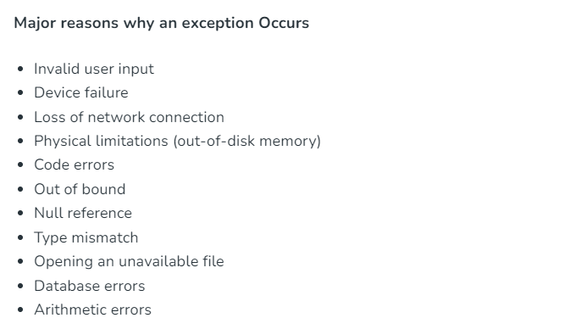
Exceptions in Java
Exception Handling in Java is one of the effective means to handle runtime errors so that the regular flow of the application can be preserved. Java Exception Handling is a mechanism to handle runtime errors such as ClassNotFoundException, IOException, SQLException, RemoteException, etc.

Slide 17
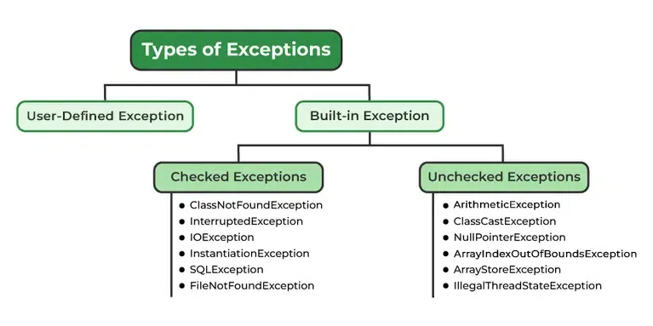
Types of Exceptions

Slide 18
Examples of Exception
// Java program to demonstrate ArithmeticException
class ArithmeticException_Demo
{
public static void main(String args[])
{
try {
int a = 30, b = 0;
int c = a/b; // cannot divide by zero
System.out.println ("Result = " + c);
}
catch(ArithmeticException e) {
System.out.println ("Can't divide a number by 0");
} ) }

Slide 19
Multi Threading
Multithreading is a Java feature that allows concurrent execution of two or more parts of a program for maximum utilization of CPU. Each part of such program is called a thread. So, threads are light-weight processes within a process.
Threads can be created by using two mechanisms :
Extending the Thread class
Implementing the Runnable Interface

Slide 20
1). Thread creation by extending the Thread class
A class that extends the java.lang.Thread class. This class overrides the run() method available in the Thread class. A thread begins its life inside run() method. Create an object of our new class and call start() method to start the execution of a thread. Start() invokes the run() method on the Thread object.
Example on next slide.

Slide 21
class MultithreadingDemo extends Thread {
public void run()
{
try {
// Displaying the thread that is running
System.out.println(
"Thread " + Thread.currentThread().getId()
+ " is running");
}
catch (Exception e) {
// Throwing an exception
System.out.println("Exception is caught");}}}
// Main Class
public class Multithread {
public static void main(String[] args)
{
int n = 8; // Number of threads
for (int i = 0; i < n; i++) {
MultithreadingDemo object
= new MultithreadingDemo();
object.start();}}}

Slide 22
Thread creation by implementing the Runnable Interface
We create a new class which implements java.lang.Runnable interface and override run() method. Then we instantiate a Thread object and call start() method on this object.
Example on next slide.
Thread Class vs Runnable Interface
If we extend the Thread class, our class cannot extend any other class because Java doesn’t support multiple inheritance. But, if we implement the Runnable interface, our class can still extend other base classes.
We can achieve basic functionality of a thread by extending Thread class because it provides some inbuilt methods like yield(), interrupt() etc. that are not available in Runnable interface.
Using runnable will give you an object that can be shared amongst multiple threads.

Slide 23
class MultithreadingDemo implements Runnable {
public void run()
{
try {
// Displaying the thread that is running
System.out.println(
"Thread " + Thread.currentThread().getId()
+ " is running");
}
catch (Exception e) {
// Throwing an exception
System.out.println("Exception is caught");}}}
// Main Class
class Multithread {
public static void main(String[] args)
{
int n = 8; // Number of threads
for (int i = 0; i < n; i++) {
Thread object
= new Thread(new MultithreadingDemo());
object.start();}}}

Slide 24
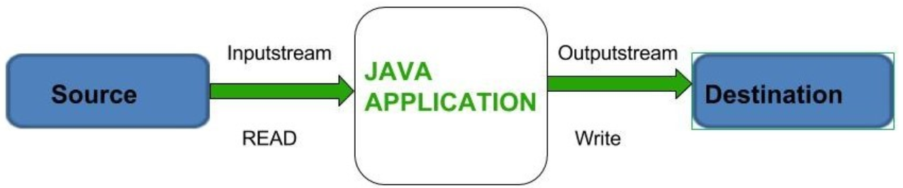
IO Streams
Java brings various Streams with its I/O package that helps the user to perform all the input-output operations. These streams support all the types of objects, data-types, characters, files etc to fully execute the I/O operations.

Slide 25
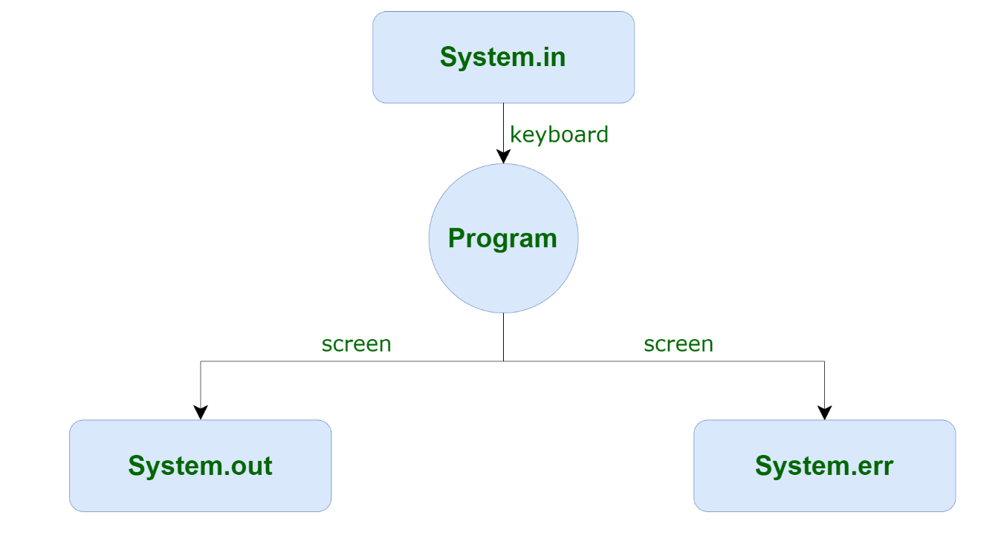
Before exploring various input and output streams lets look at 3 standard or default streams that Java has to provide which are also most common in use:

Slide 26
Java.io.Reader class in Java
Java Reader class is an abstract class for reading character streams. The only methods that a subclass must implement are read(char[], int, int), and close(). Most subclasses, however, will override some of the methods defined here in order to provide higher efficiency, additional functionality, or both.
Constructors in Java Reader Class
There are two constructors used with Java Reader Class as mentioned below:
protected Reader(): Creates a new character-stream reader whose critical sections will synchronize on the reader itself.
protected Reader(Object lock): Creates a new character-stream reader whose critical sections will synchronize on the given object.

Slide 28
AWT (Abstract windowtooldkit)
Java AWT (Abstract Window Toolkit) is an API to develop Graphical User Interface (GUI) or windows-based applications in Java.
Java AWT components are platform-dependent i.e. components are displayed according to the view of operating system. AWT is heavy weight i.e. its components are using the resources of underlying operating system (OS).
The java.awt package provides classes for AWT API such as TextField, Label, TextArea, RadioButton, CheckBox, Choice, List etc.

Slide 29
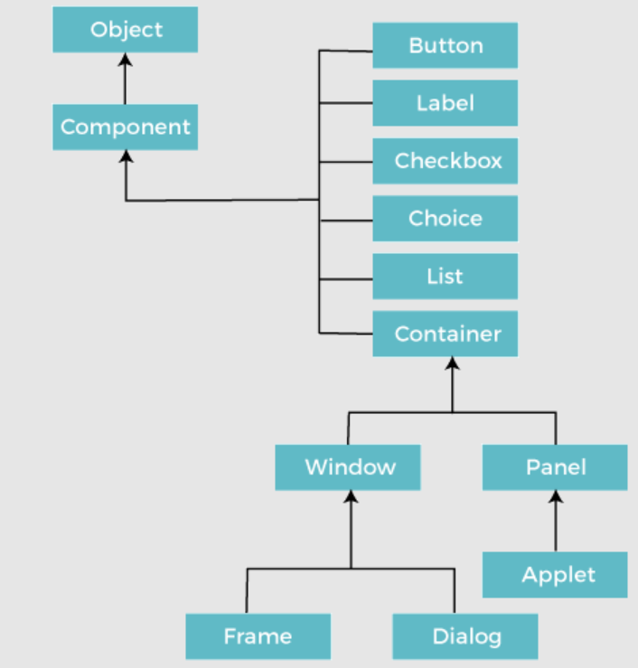
Java AWT Hierarchy

Slide 30
Java AWT Example
To create simple AWT example, you need a frame. There are two ways to create a GUI using Frame in AWT.
By extending Frame class (inheritance)
By creating the object of Frame class (association)

Slide 31
import java.awt.*;
// extending Frame class to our class AWTExample1
public class AWTExample1 extends Frame {
// initializing using constructor
AWTExample1() {
Button b = new Button("Click Me!!");
b.setBounds(30,100,80,30);
add(b);
setSize(300,300);
setTitle("This is our basic AWT example");
setLayout(null);
setVisible(true); }
public static void main(String args[]) {
AWTExample1 f = new AWTExample1();
} }

Slide 32
Java Collections
The Collection in Java is a framework that provides an architecture to store and manipulate the group of objects.
Java Collections can achieve all the operations that you perform on a data such as searching, sorting, insertion, manipulation, and deletion.
Java Collection means a single unit of objects. Java Collection framework provides many interfaces (Set, List, Queue, Deque) and classes (ArrayList, Vector, LinkedList, PriorityQueue, HashSet, LinkedHashSet, TreeSet).
The Collection framework represents a unified architecture for storing and manipulating a group of objects. It has:
Interfaces and its implementations, i.e., classes
Algorithm

Slide 33
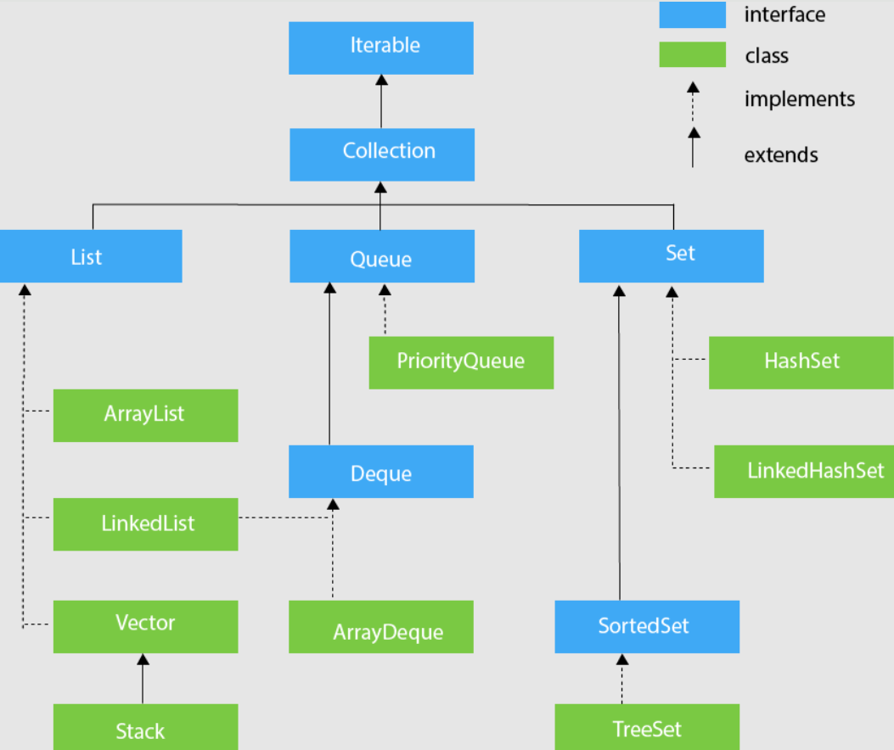
Hierarchy of Collection Framework

Slide 34
Collection Interface
The Collection interface is the interface which is implemented by all the classes in the collection framework. It declares the methods that every collection will have. In other words, we can say that the Collection interface builds the foundation on which the collection framework depends.
Some of the methods of Collection interface are Boolean add ( Object obj), Boolean addAll ( Collection c), void clear(), etc. which are implemented by all the subclasses of Collection interface.

Slide 35
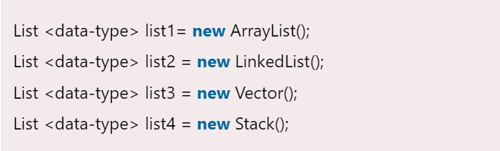
Collection Interface – List Interface
List interface is the child interface of Collection interface. It inhibits a list type data structure in which we can store the ordered collection of objects. It can have duplicate values.
List interface is implemented by the classes ArrayList, LinkedList, Vector, and Stack.

Slide 36
Java Swing
Swing is a Java Foundation Classes [JFC] library and an extension of the Abstract Window Toolkit [AWT].
Java Swing offers much-improved functionality over AWT, new components, expanded components features, and excellent event handling with drag-and-drop support.
Swing has about four times the number of User Interface [UI] components as AWT and is part of the standard Java distribution.
By today’s application GUI requirements, AWT is a limited implementation, not quite capable of providing the components required for developing complex GUIs required in modern commercial applications.

Slide 37
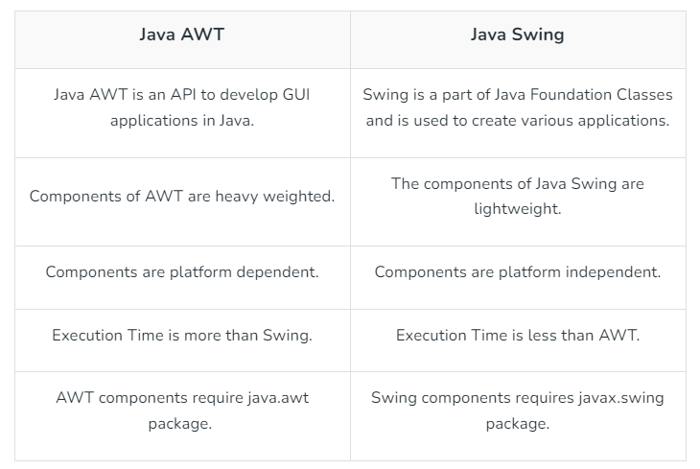
Difference between Java Swing and Java AWT

Slide 38
Features Of Swing Class
Pluggable look and feel.
Uses MVC architecture.
Lightweight Components
Platform Independent
Advanced features such as JTable, JTabbedPane, JScollPane, etc.
Java is a platform-independent language and runs on any client machine, the GUI look and feel, owned and delivered by a platform-specific O/S, simply does not affect an application’s GUI constructed using Swing components.

Slide 39
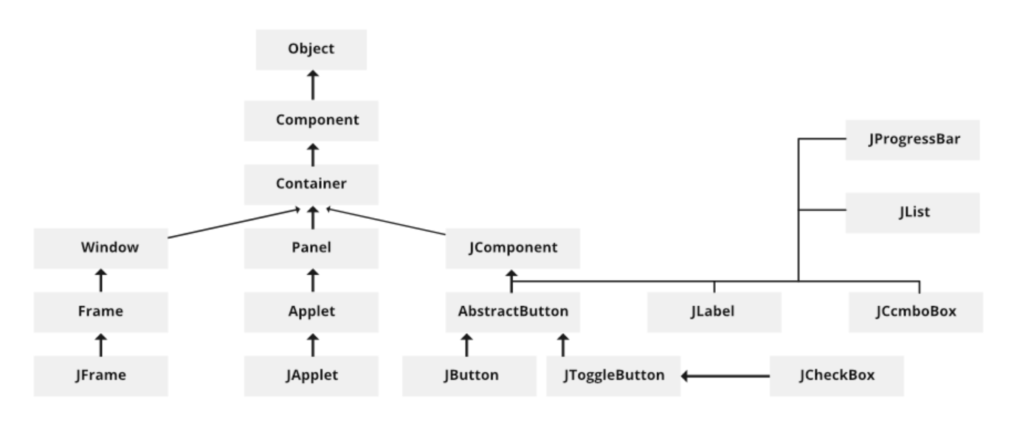
Swing Classes Hierarchy

Slide 40
Swing Example

Slide 41
Swing Example- Creating Windows

Slide 42
Swing Example- Frames

Slide 43
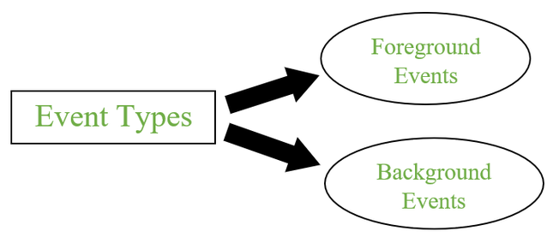
Event handling in Desktop applications
An event can be defined as changing the state of an object or behavior by performing actions. Actions can be a button click, cursor movement, keypress through keyboard or page scrolling, etc.
The java.awt.event package can be used to provide various event classes.
Classification of Events
Foreground Events
Background Events

Slide 44
1. Foreground Events
Foreground events are the events that require user interaction to generate, i.e., foreground events are generated due to interaction by the user on components in Graphic User Interface (GUI). Interactions are nothing but clicking on a button, scrolling the scroll bar, cursor moments, etc.
2. Background Events
Events that don’t require interactions of users to generate are known as background events. Examples of these events are operating system failures/interrupts, operation completion, etc.

Slide 45
Flow of Event Handling
User Interaction with a component is required to generate an event.
The object of the respective event class is created automatically after event generation, and it holds all information of the event source.
The newly created object is passed to the methods of the registered listener.
The method executes and returns the result.

Slide 47
Java Stream
Introduced in Java 8, Stream API is used to process collections of objects. A stream in Java is a sequence of objects that supports various methods that can be pipelined to produce the desired result.
The uses of Stream in Java are mentioned below:
Stream API is a way to express and process collections of objects.
Enable us to perform operations like filtering, mapping, reducing, and sorting.

Slide 48
The features of Java stream are mentioned below:
A stream is not a data structure instead it takes input from the Collections, Arrays or I/O channels.
Streams don’t change the original data structure, they only provide the result as per the pipelined methods.
Each intermediate operation is lazily executed and returns a stream as a result, hence various intermediate operations can be pipelined. Terminal operations mark the end of the stream and return the result.

Slide 49
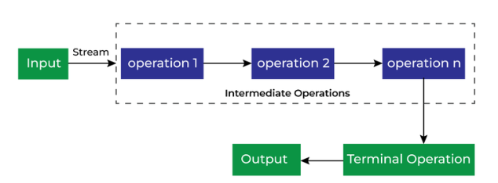
There are two types of Operations in Streams:
Intermediate Operations
Terminate Operations
Intermediate Operations

Slide 50
Benefit of Java Stream
There are some benefits because of which we use Stream in Java as mentioned below:
No Storage
Pipeline of Functions
Laziness
Can be infinite
Can be parallelized
Can be created from collections, arrays, Files Lines, Methods in Stream, IntStream etc.

Slide 51
Functional Interfaces
A functional interface is an interface that contains only one abstract method. They can have only one functionality to exhibit.
From Java 8 onwards, lambda expressions can be used to represent the instance of a functional interface.
A functional interface can have any number of default methods. Runnable, ActionListener, and Comparable are some of the examples of functional interfaces

Slide 52
Java Functional Interfaces
class Test {
public static void main(String args[])
{
// create anonymous inner class object
new Thread(new Runnable() {
@Override public void run()
{
System.out.println("New thread created");
}
}).start();
}
}

Slide 53
Lambda in Java
A lambda expression is a short block of code which takes in parameters and returns a value. Lambda expressions are similar to methods, but they do not need a name and they can be implemented right in the body of a method.
Syntax:-
The simplest lambda expression contains a single parameter and an expression:
parameter -> expression
To use more than one parameter, wrap them in parentheses:
(parameter1, parameter2) -> expression

Slide 54
Using Lambda Expressions:- Lambda expressions are usually passed as parameters to a function:
Example:- Use a lambda expression in the ArrayList's forEach() method to print every item in the list:
import java.util.ArrayList;
public class Main {
public static void main(String[] args) {
ArrayList<Integer> numbers = new ArrayList<Integer>();
numbers.add(5);
numbers.add(9);
numbers.add(8);
numbers.add(1);
numbers.forEach( (n) -> { System.out.println(n); } );}}

Slide 55
Java Regex
A regular expression is a sequence of characters that forms a search pattern. When you search for data in a text, you can use this search pattern to describe what you are searching for.
A regular expression can be a single character, or a more complicated pattern.
Regular expressions can be used to perform all types of text search and text replace operations.
Java does not have a built-in Regular Expression class, but we can import the java.util.regex package to work with regular expressions. The package includes the following classes:
Pattern Class - Defines a pattern (to be used in a search)
Matcher Class - Used to search for the pattern
PatternSyntaxException Class - Indicates syntax error in a regular expression pattern

Slide 56
Java Regex Example
import java.util.regex.Matcher;
import java.util.regex.Pattern;
public class Main {
public static void main(String[] args) {
Pattern pattern = Pattern.compile("w3schools", Pattern.CASE_INSENSITIVE);
Matcher matcher = pattern.matcher("Visit W3Schools!");
boolean matchFound = matcher.find();
if(matchFound) {
System.out.println("Match found");
} else {
System.out.println("Match not found");
}
}
}
// Outputs Match found

Slide 57
Flags
Flags in the compile() method change how the search is performed. Here are a few of them:
Pattern.CASE_INSENSITIVE - The case of letters will be ignored when performing a search.
Pattern.LITERAL - Special characters in the pattern will not have any special meaning and will be treated as ordinary characters when performing a search.
Pattern.UNICODE_CASE - Use it together with the CASE_INSENSITIVE flag to also ignore the case of letters outside of the English alphabet

Slide 58
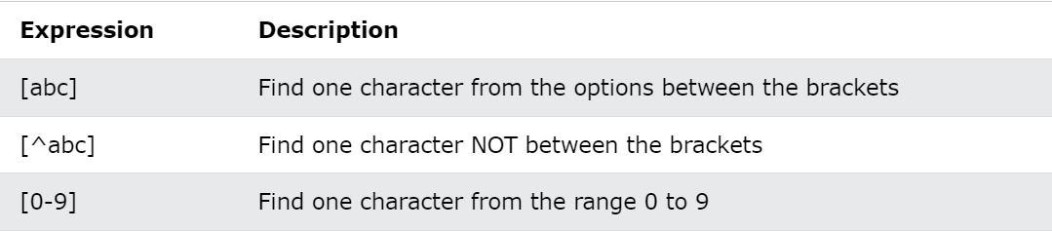
Regular Expression Patterns
The first parameter of the Pattern.compile() method is the pattern. It describes what is being searched for.
Brackets are used to find a range of characters:

Slide 59
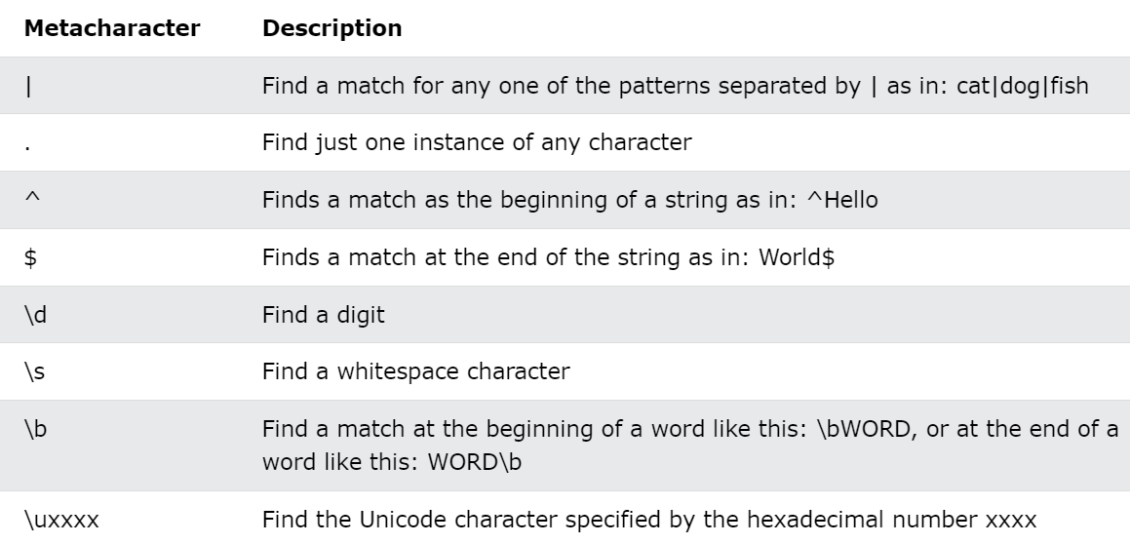
Metacharacters
Metacharacters are characters with a special meaning:

Slide 60
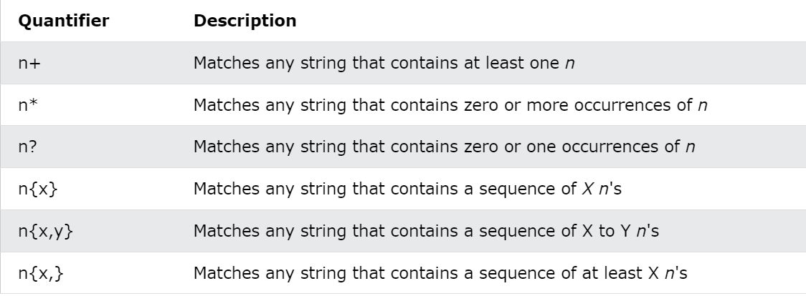
Quantifiers
Quantifiers define quantities:

Slide 61
Java Concurrency
Java is a multi-threaded programming language which means we can develop multi-threaded program using Java.
A multi-threaded program contains two or more parts that can run concurrently, and each part can handle a different task at the same time making optimal use of the available resources specially when your computer has multiple CPUs.
Multi-threading enables you to write in a way where multiple activities can proceed concurrently in the same program.
Multi-threading enables you to write in a way where multiple activities can proceed concurrently in the same program.

Slide 62
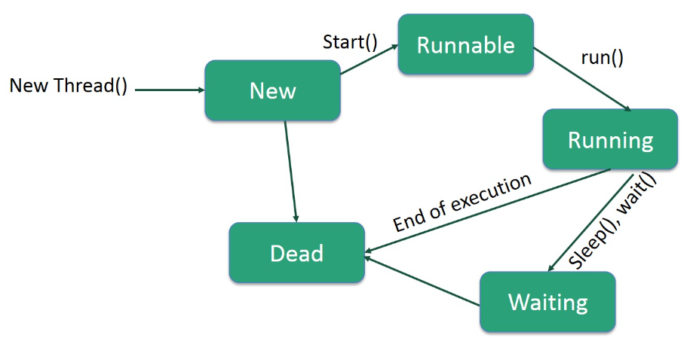
Life Cycle of a Thread
A thread goes through various stages in its life cycle. For example, a thread is born, started, runs, and then dies. The following diagram shows the complete life cycle of a thread.

Slide 63
Following are the stages of the life cycle −
New − A new thread begins its life cycle in the new state. It remains in this state until the program starts the thread. It is also referred to as a born thread.
Runnable − After a newly born thread is started, the thread becomes runnable. A thread in this state is considered to be executing its task.
Waiting − Sometimes, a thread transitions to the waiting state while the thread waits for another thread to perform a task. A thread transitions back to the runnable state only when another thread signals the waiting thread to continue executing.
Timed Waiting − A runnable thread can enter the timed waiting state for a specified interval of time. A thread in this state transitions back to the runnable state when that time interval expires or when the event it is waiting for occurs.
Terminated (Dead) − A runnable thread enters the terminated state when it completes its task or otherwise terminates.

Slide 64
Java Concurrency - Example

Slide 65
JDBC
JDBC stands for Java Database Connectivity. JDBC is a Java API to connect and execute the query with the database.
It is a specification from Sun Microsystems that provides a standard abstraction(API or Protocol) for Java applications to communicate with various databases.
It provides the language with Java database connectivity standards.
It is used to write programs required to access databases. JDBC, along with the database driver, can access databases and spreadsheets.
The enterprise data stored in a relational database(RDB) can be accessed with the help of JDBC APIs.

Slide 66
Components of JDBC
There are generally four main components of JDBC through which it can interact with a database. They are as mentioned below:
1. JDBC API: It provides various methods and interfaces for easy communication with the database. It provides two packages as follows, which contain the java SE and Java EE platforms to exhibit WORA(write once run anywhere) capabilities. The java.sql package contains interfaces and classes of JDBC API.
2. JDBC Driver manager: It loads a database-specific driver in an application to establish a connection with a database. It is used to make a database-specific call to the database to process the user request.
3. JDBC Test suite: It is used to test the operation(such as insertion, deletion, updation) being performed by JDBC Drivers.

Slide 67
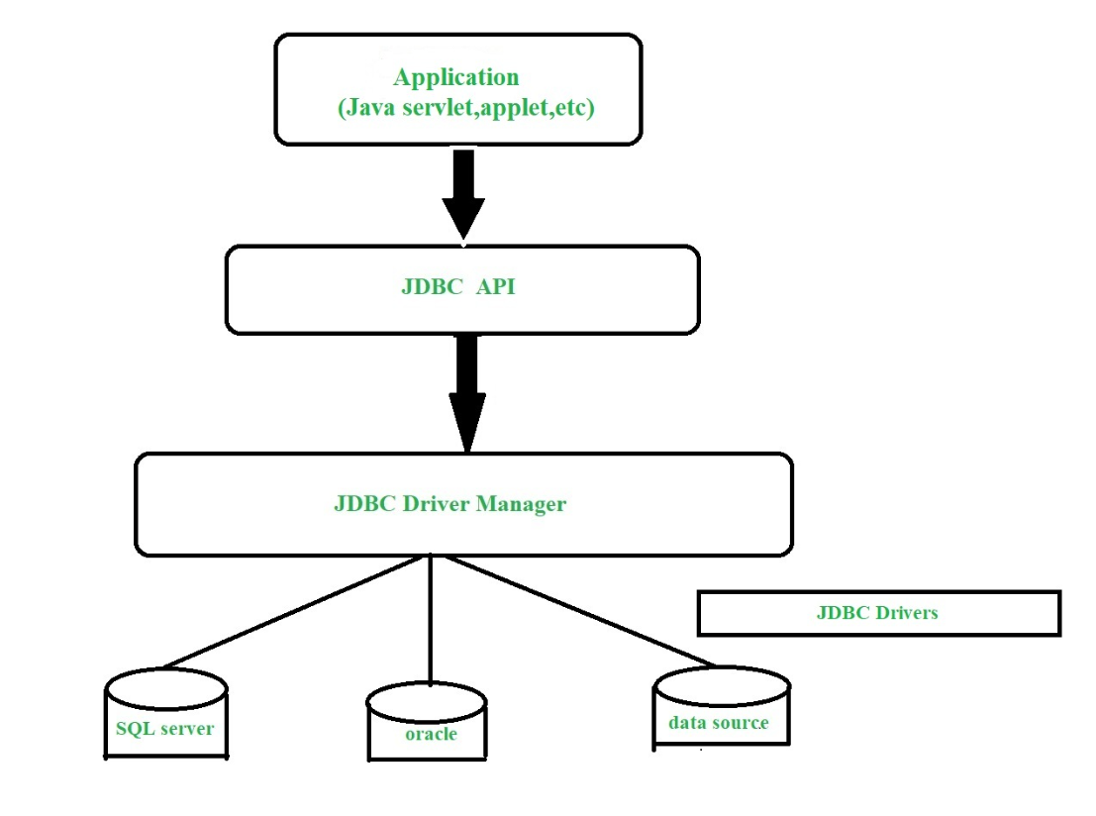
Components of JDBC
4. JDBC-ODBC Bridge Drivers: It connects database drivers to the database. This bridge translates the JDBC method call to the ODBC function call. It makes use of the sun.jdbc.odbc package which includes a native library to access ODBC characteristics.

Slide 68
Working of JDBC
Double click to open and copy the code.

Slide 69
Spring Cloud
Spring Cloud provides tools for developers to quickly build some of the common patterns in distributed systems (e.g. configuration management, service discovery, circuit breakers, intelligent routing, micro-proxy, control bus, short lived microservices and contract testing).
Coordination of distributed systems leads to boiler plate patterns, and using Spring Cloud developers can quickly stand up services and applications that implement those patterns.
They will work well in any distributed environment, including the developer’s own laptop, bare metal data centres, and managed platforms such as Cloud Foundry.

Slide 70
Spring Cloud focuses on providing good out of box experience for typical use cases and extensibility mechanism to cover others.
Distributed/versioned configuration
Service registration and discovery
Routing
Service-to-service calls
Load balancing
Circuit Breakers
Distributed messaging
Short lived microservices (tasks)
Consumer-driven and producer-driven contract testing

Slide 71
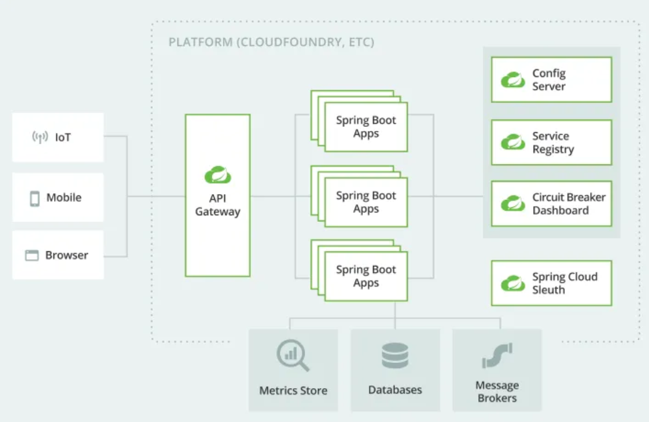
Spring Cloud: Architecture
Representation of a microservices architecture on a cloud platform

Slide 72
Spring Cloud Configuration
Spring Cloud Config provides server-side and client-side support for externalized configuration in a distributed system.
With the Config Server, you have a central place to manage external properties for applications across all environments.
The concepts on both client and server map identically to the Spring Environment and PropertySource abstractions, so they fit very well with Spring applications but can be used with any application running in any language.
As an application moves through the deployment pipeline from dev to test and into production, you can manage the configuration between those environments and be certain that applications have everything they need to run when they migrate.

Slide 73
Configuring Spring Cloud Services with Git
Spring Cloud Services Config provides a Git backend so that the Spring Cloud Config Server can serve configuration stored in Git.
The Spring Cloud Services Config Server supports this backend and can serve configuration stored in Git to client apps when given the URL to a Git repository (for example, the URL of a repository hosted on GitHub or Bitbucket).
Git is a distributed version control system (DVCS). It encourages parallel development through simplified branching and merging, optimizes performance by conducting many operations on the local copy of the repository, and uses SHA-1 hashes for checksums to assure integrity and guard against corruption of repository data.

Slide 74
Spring Cloud Services Config provides a Git backend so that the Spring Cloud Config Server can serve configuration stored in Git.
The Spring Cloud Services Config Server supports this backend and can serve configuration stored in Git to client apps when given the URL to a Git repository (for example, the URL of a repository hosted on GitHub or Bitbucket).
Git is a distributed version control system (DVCS). It encourages parallel development through simplified branching and merging, optimizes performance by conducting many operations on the local copy of the repository, and uses SHA-1 hashes for checksums to assure integrity and guard against corruption of repository data.

Slide 75
Spring Cloud – Netflix Eureka - Overview
Service Discovery plays a very important role in microservice-based architecture. Eureka is the Netflix Service Discovery Server and Client.
The server can be configured and deployed to be highly functional, with each server copying the state of the registered services to the others.
With Netflix Eureka, every client can simultaneously act as a server to replicate its status to a connected peer. In other words, a client retrieves a list of all connected peers in a service registry and makes all further requests to other services through a load-balancing algorithm.

Slide 76
Spring Cloud – Netflix Eureka - Configuration
Develop Service Discovery using Netflix Eureka
In Microservices, Service Discovery helps us by providing a database of available service instances so that services can be discovered, registered, and de-registered based on usage.
Eureka Server is an application that holds the information about all client-service applications. Every Micro service will register into the Eureka server and Eureka server knows all the client applications running on each port and IP address. Eureka Server is also known as Discovery Server.
Components of Eureka
Eureka Server: Acts as a service registry where all services register themselves. The Eureka Server is a standalone application that keeps track of all services and their instances.
Eureka Client: Any service that registers with the Eureka Server. It also fetches the registry information from the server to discover other services.

Slide 77
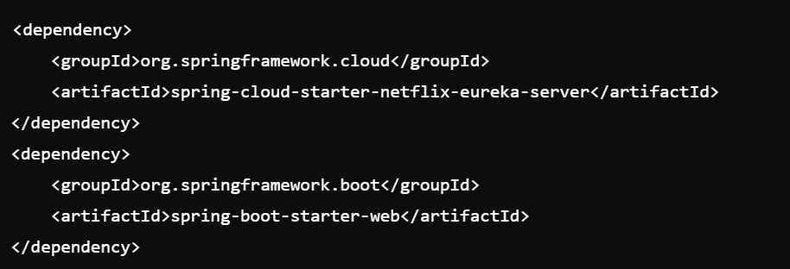
Setting Up Eureka Server in Java
Step 1: Add Maven Dependencies
Include the necessary dependencies in your pom.xml file:

Slide 78
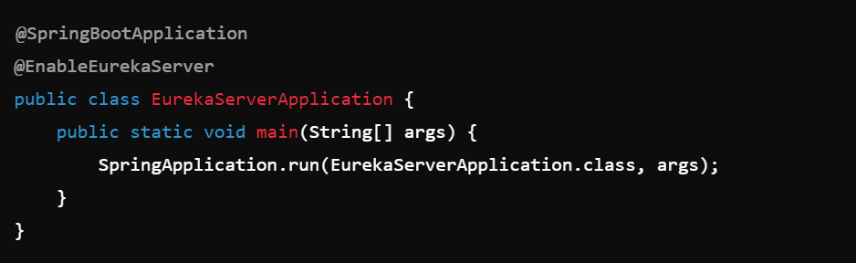
Step 2: Enable Eureka Server
Create a Spring Boot application and annotate it with @EnableEurekaServer to enable the Eureka Server functionality.

Slide 79
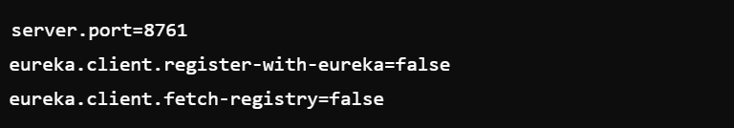
Step 3: Configure Application Properties
In your application.properties or application.yml, configure the necessary settings:
server.port: The port on which the Eureka Server will run.
eureka.client.register-with-eureka: Set to false because the server itself should not register as a client.
eureka.client.fetch-registry: Set to false because the server does not need to fetch the registry.

Slide 80
Step 4: Run the Eureka Server
Run the application, and the Eureka Server will be available on http://localhost:8761.

Slide 81
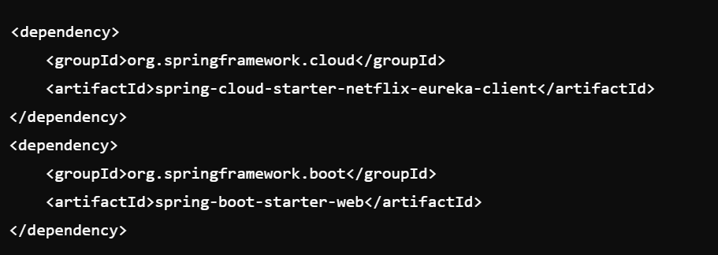
Setting Up Eureka Client
Configuring a Eureka Client involves setting up a microservice to register itself with a Eureka Server and discover other services registered with that server. Here's a step-by-step guide to configuring a Eureka Client in a Spring Boot application.
Add Eureka Client Dependencies
First, you need to add the necessary dependencies for Eureka Client in your pom.xml file if you're using Maven:

Slide 82
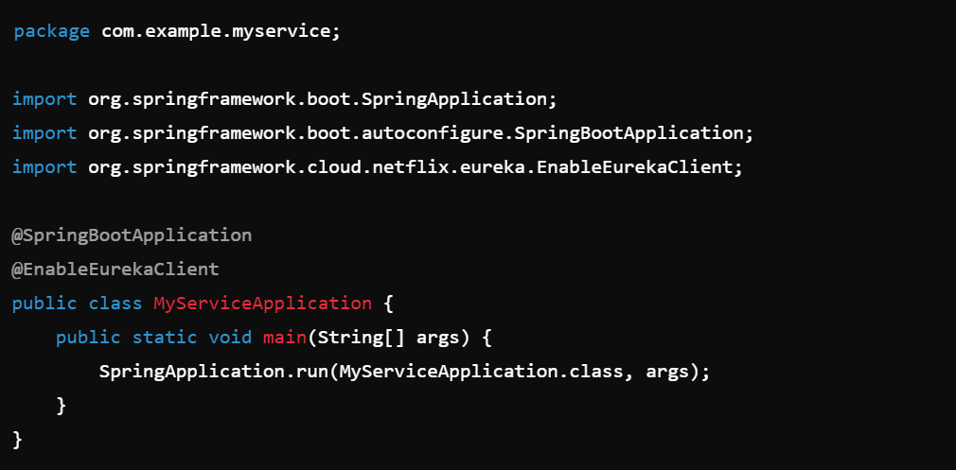
2. Enable Eureka Client
Next, you need to enable the Eureka Client in your Spring Boot application by annotating your main application class with @EnableEurekaClient. This annotation is optional if you have spring-cloud-starter-netflix-eureka-client in your classpath, as Spring Boot auto-configures the client by default. However, it's a good practice to include it explicitly for clarity.

Slide 83
3. Configure Application Properties:- You need to configure the Eureka Client settings in your application.properties or application.yml file to specify how the service interacts with the Eureka Server.
4. Start the Service:- Once you've configured the application, start your Spring Boot application. The service will automatically register itself with the Eureka Server and appear on the Eureka dashboard (usually accessible at http://localhost:8761 if running locally).
5. Discovering Other Services:- Once your service is registered with Eureka, you can discover other services by using their spring.application.name in requests.
6. Monitoring and Troubleshooting:- Eureka Dashboard: Monitor the registered services via the Eureka dashboard at http://localhost:8761.

Slide 84
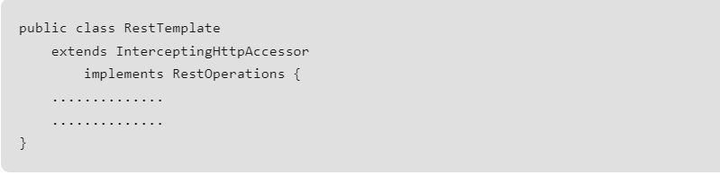
Spring Boot Microservices Communication using RestTemplate
RestTemplate is a synchronous REST client which performs HTTP requests using a simple template-style API. We can also state that RestTemplate class is a synchronous client and is designed to call REST services.
Apart from that, RestTemplate class plays a major role whenever we talk about Spring Boot Microservices Communication. The basic syntax of this class is given below.

Slide 85
Spring Cloud OpenFeign
Spring Cloud OpenFeign is a declarative web service client that makes it easier to call REST services in Spring Boot applications. Instead of writing complex code to handle HTTP requests and responses, you can use Feign to simplify the process by just defining an interface and annotating it.
OpenFeign integrates seamlessly with other Spring Cloud components like Eureka for service discovery and Ribbon for client-side load balancing.
Key Features of Spring Cloud OpenFeign:
Declarative REST Client: You can declare your REST client interfaces and methods directly, reducing boilerplate code.
Integration with Spring Cloud: OpenFeign works well with other Spring Cloud components, such as Eureka for service discovery and Ribbon for client-side load balancing.
Support for Circuit Breakers: You can integrate OpenFeign with Resilience4j or Hystrix to add circuit breakers to your REST clients, enhancing fault tolerance.

Slide 86
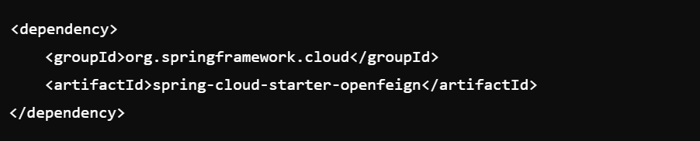
Example of how to use Spring Cloud OpenFeign:
1). Add Dependencies: In your pom.xml (for Maven) or build.gradle (for Gradle), include the necessary dependencies:

Slide 87
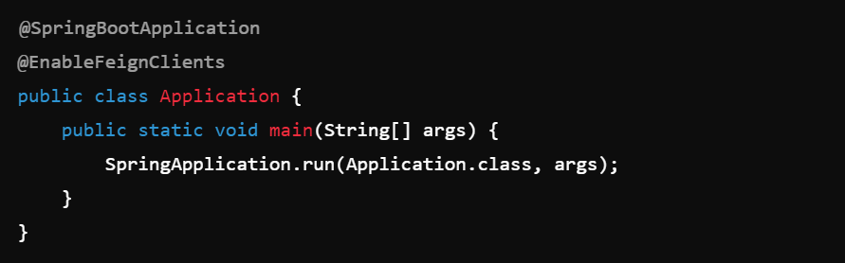
2). Enable Feign Clients: In your Spring Boot application class, enable Feign clients by adding the @EnableFeignClients annotation:

Slide 88
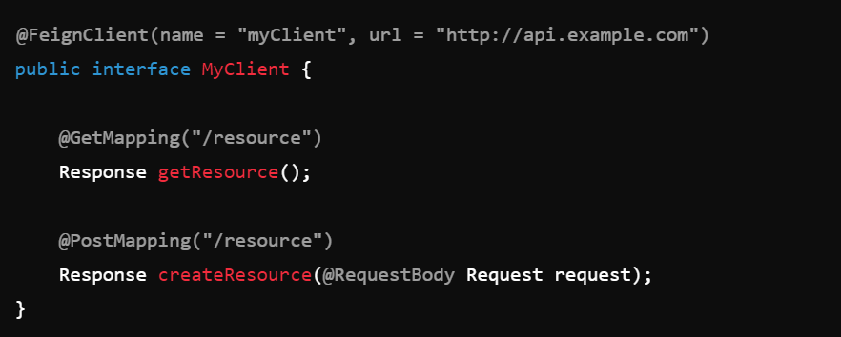
Define a Feign Client Interface: Create an interface that declares the REST endpoints you want to call:

Slide 89
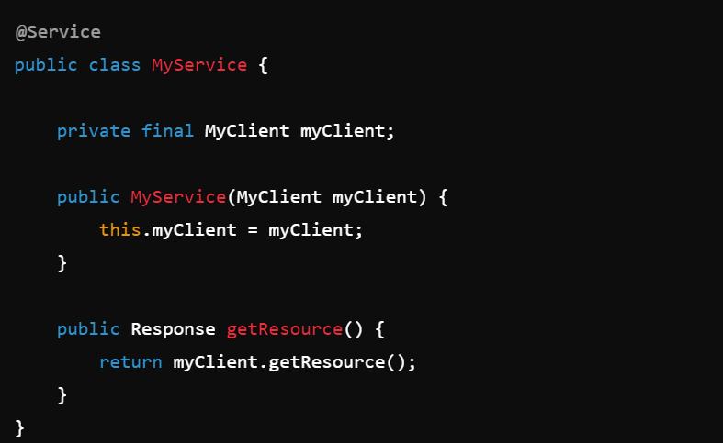
Use the Feign Client: You can now inject and use the Feign client in your services or controllers:

Slide 90
Advantages of Using Spring Cloud OpenFeign:
Simplifies HTTP client creation: Reduces the amount of code required to make HTTP calls.
Seamless integration: Works well with other Spring Cloud components, making it ideal for microservices architectures.
Easy to use: Declarative and intuitive, making it easy to understand and use.

Slide 91
Load Balancing
Load balancing is a technique used in distributed systems to distribute incoming network traffic across multiple servers or resources to ensure no single server is overwhelmed. This helps optimize resource use, maximize throughput, minimize response time, and avoid overloading any single server, which can lead to failures.
Types of Load Balancers
Hardware Load Balancers: Dedicated physical devices specifically built for load balancing. They are often used in data centers and can be expensive.
Software Load Balancers: Applications or services running on standard hardware or virtual machines that provide load balancing capabilities. Examples include HAProxy, NGINX, and software-based solutions in cloud environments.
Cloud Load Balancers: Load balancing services provided by cloud providers like AWS Elastic Load Balancing, Google Cloud Load Balancing, and Azure Load Balancer.

Slide 92
Load Balancing Algorithms
Round Robin: Distributes requests sequentially to each server in a circular order.
Least Connections: Directs traffic to the server with the fewest active connections.
IP Hash: Uses the client’s IP address to determine which server receives the request, ensuring a client is consistently directed to the same server.
Weighted Round Robin: Similar to Round Robin, but servers with higher capacities receive a higher proportion of requests.
Least Response Time: Routes traffic to the server with the quickest response time and the fewest active connections.
Geographic Load Balancing: Routes requests to servers closest to the client’s geographical location, reducing latency.

Slide 93
Client-side load balancer
A client-side load balancer is a load balancing mechanism where the load balancing logic resides within the client application itself, rather than on a centralized server.
In this approach, the client is responsible for determining which server or instance to send requests to. This contrasts with a traditional server-side load balancer, where the load balancer sits between the client and the servers and directs traffic accordingly.
Key Concepts of Client-Side Load Balancing:
Distributed Load Balancing Logic.
Service Discovery.
Load Balancing Algorithms.
No Single Point of Failure
Direct Connection to Servers

Slide 94
Use Cases for Client-Side Load Balancing:
Microservices Architectures:
In microservices environments, particularly those using service meshes, client-side load balancing is common. Clients can discover and route requests directly to microservices instances without a centralized load balancer, using tools like Spring Cloud Ribbon or Envoy.
Edge Computing:
In edge computing, where services are distributed across many locations, client-side load balancing allows devices to choose the closest or most suitable service instance, reducing the need for centralized load balancers.

Slide 95
Circuit Breaking
Circuit breaking is a design pattern used in software development, particularly in microservices architectures, to improve the stability and resilience of applications.
It acts as a safeguard that prevents a system from repeatedly attempting to execute an operation that is likely to fail, thus avoiding prolonged outages or cascading failures.
Key Concepts of Circuit Breaking:
Circuit Breaker: A circuit breaker monitors the interactions between services or components. If a service fails repeatedly, the circuit breaker "trips" and prevents further attempts to invoke the failing service for a certain period, allowing the system to recover.
States of a Circuit Breaker:
Closed: The circuit is functioning normally, and requests are allowed to pass through. If the number of failures exceeds a certain threshold within a specific time window, the circuit breaker transitions to the "Open" state.

Slide 96
Open: The circuit is "tripped," and no requests are sent to the failing service. Instead, the circuit breaker immediately returns a fallback response or an error. After a timeout period, the circuit breaker transitions to the "Half-Open" state.
Half-Open: The circuit breaker allows a limited number of test requests to pass through to the service. If these requests succeed, the circuit breaker resets to the "Closed" state. If they fail, the circuit breaker returns to the "Open" state.
Fallback Method:
When the circuit breaker is in the "Open" or "Half-Open" state, the application can execute a fallback method. This method provides an alternative response, often a default value, cached response, or a simplified version of the service, ensuring that the application remains responsive even if the primary service is unavailable.

Slide 97
Why Use a Circuit Breaker?
Prevent System Overload: When a service fails, continuous retries can overload the system, leading to cascading failures across the entire application. Circuit breakers prevent such overloads.
Improved Resilience: Circuit breakers allow the system to degrade gracefully, providing fallback responses instead of failing completely.
Faster Recovery: By temporarily halting requests to a failing service, the circuit breaker gives the service time to recover, improving the overall stability of the system.

Slide 98
Circuit Breaking- Real-World Use Case
Imagine an e-commerce application where multiple services interact, such as a payment service, inventory service, and order service. If the payment service starts failing, a circuit breaker can prevent the order service from continuously trying to call the payment service, avoiding a cascade of failures.
Instead, the circuit breaker would trigger a fallback method, such as queuing the order for later processing or notifying the user of a temporary issue.

Slide 99
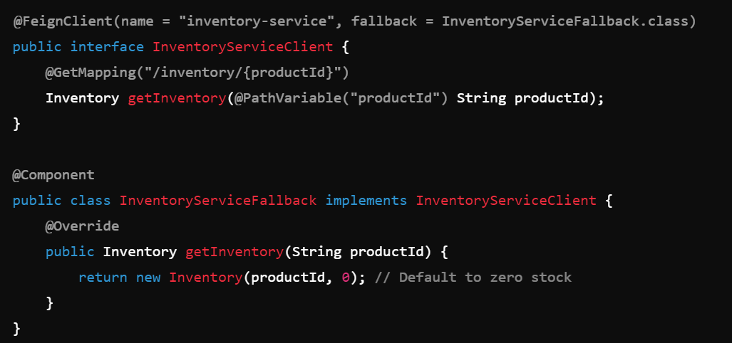
Example of a Fallback Method in Spring Boot

Slide 100
Using Resillience4J
Resilience4j is a lightweight, easy-to-use library designed to help developers build resilient and fault-tolerant applications. It provides various fault tolerance patterns like circuit breakers, rate limiters, retries, timeouts, and bulkheads, among others. Resilience4j is designed with a functional programming approach and works well with Java 8 and above.
Key Features of Resilience4j:
Circuit Breaker: Monitors calls to a remote service and opens the circuit when a certain threshold of failures is reached, preventing further calls to the service for a predefined period.
Retry: Automatically retries failed operations according to a configured policy.
Rate Limiter: Limits the number of calls to a service within a time window, preventing overload.

Slide 101
Using Resillience4J Advantages
Advantages of Using Resilience4j:
Lightweight: Resilience4j is designed to be lightweight and modular, so you can pick and choose only the components you need.
Functional Programming Support: Built with functional programming principles in mind, Resilience4j fits well in modern Java applications.
Integration: Integrates seamlessly with Spring Boot, making it easy to implement in existing projects.

Slide 102
Using Resillience4J - Example Scenario
Imagine an application that relies on an external API to fetch data. If the API becomes unreliable, the circuit breaker will open after a certain number of failures, preventing further calls to the API. During this time, the application can fall back to a cached response or an alternative service until the API becomes stable again.

Slide 103
Scenario Overview
Imagine a microservices-based e-commerce application where:
Order Service: Handles customer orders.
Inventory Service: Checks the stock availability of products.
Product Service: Fetches product details from an external API (e.g., a third-party product information service).

Slide 104
Example Scenario
The Product Service is critical for the Order Service to function, but it occasionally becomes slow or unreliable.
To handle this, we'll use Resilience4j to:
Implement a Circuit Breaker: Prevents the Order Service from calling the Product Service if it's consistently failing.
Add Retry Logic: Automatically retries the request to the Product Service if it fails temporarily.
Define a Fallback Method: Provides a default response when the Product Service is unavailable.

